Slide 1


CEA Testing
Team members:
Ron Dickerson
Mahima Joshi
Janet Pan
Anuradha Ramachandran

Slide 2
Agenda
Background
Packages
Appeal of chosen package
Drawback of chosen package
Application of package

Slide 3
Project Overview
Background: Patients who have completed curative treatment for colorectal cancer (CRC) should be followed up for the development of recurrent disease and require surveillance for five years post-treatment
Statement of the Problem: In practice, patients do not receive frequent testing
Opportunity: Increase adherence to guideline-recommended testing; reduce cost
Aim:
Identify patient and physician characteristics that predict a patient's likelihood of being tested in the next three months
Build an interactive software system designed to help clinicians with identifying patients for CEA testing using the model.

Slide 4
ML packages considered
Packages | Appeal | Drawback
Pytorch/ Tensorflow | Used for Deep learning framework Aids in customization of models Optimized to run on GPUs and handles parallel processing | More challenging learning curve Limited direct applicability to non-deep learning domains
Scikit-Learn | Beginner friendly and interfaces easily with NumPy, SciPy libraries Built in models for regression, clustering, classification Built-in cross-validation and model assessment functionality Extensive documentation | Lacks efficient parallel processing Doesn’t efficiently handle sparse data Cannot customize model It does not do sequential and time-series analysis.

Slide 5
Appeal of using Scikit Learn
Beginner-friendly (numpy, SciPy)
ML library (random forest, regression, clustering, etc)
Built-in cross-validation and model assessment functionality
Have less issues to resolve
Bigger community

Slide 6
Drawbacks of using Scikit Learn
It lacks efficient parallel processing
Doesn’t efficiently handle sparse data
Cannot customize model
It does not do sequential and time-series analysis.

Slide 7
Scikit Learn- how it works
Data pre-processing
Data needs to be numeric and can be imported as dataframe via pandas, arrays via NumPy, or sparse matrices via SciPy
Need to establish a test dataset and a validation dataset, or we can also do cross-validation.
Using sklearn.processing and sklearn.model_selection
Model fitting
Fit model (lasso, elastic net, random forest, elastic net, ridge, xg boost).
Model evaluation
Using sklearn.metric

Slide 8
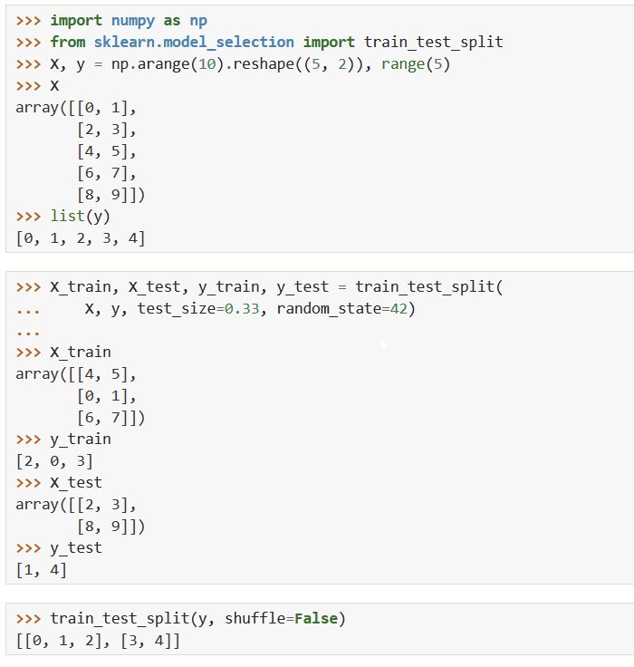
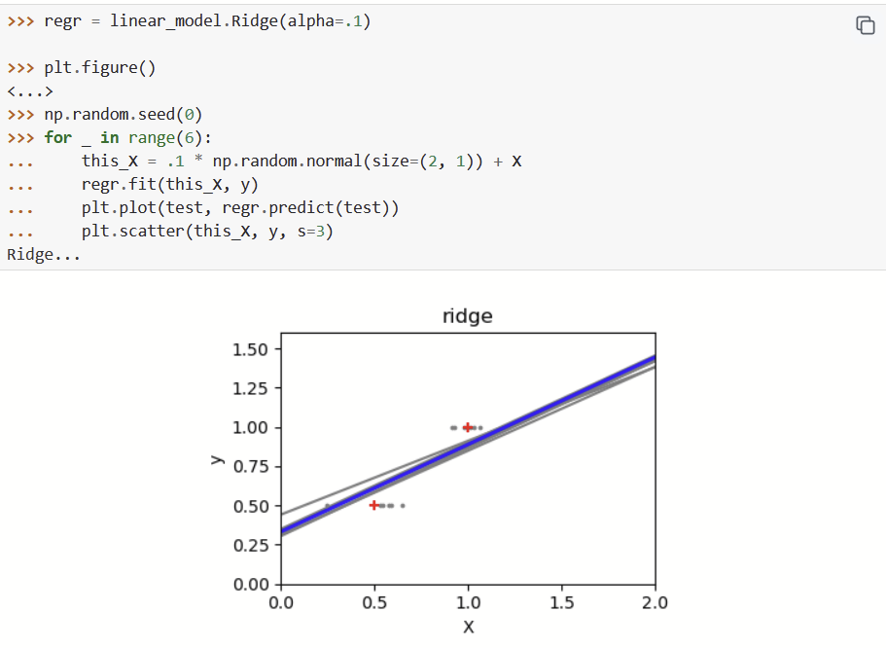
Example- Preprocessing data
Example- Model fitting: Ridge
Notes:
https://scikit-learn.org/stable/tutorial/statistical_inference/supervised_learning.html
Testing: https://scikit-learn.org/stable/modules/generated/sklearn.model_selection.train_test_split.html

Slide 9
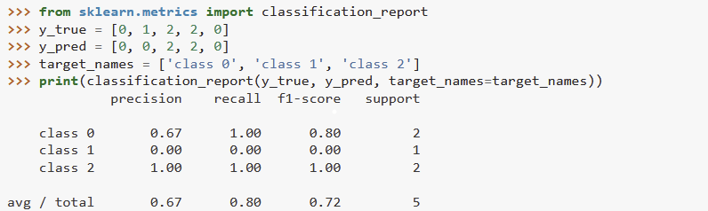
Example- model evaluation
Notes:
https://scikit-learn.org/0.15/modules/model_evaluation.html
Example of classification report, and can calculate the precision, f1-score, and support to tell us the model evaluation. This is one of the build in metric for evaluate the model performance,

Slide 10
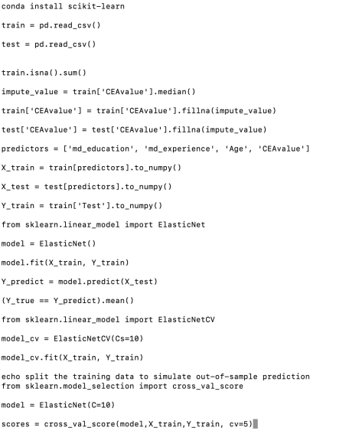
Application on our data
Preprocessing data
2. Model fitting- supervised

